Slide 1
Automated Channel-Specific Cofactors for Transforming Flow Cytometry, CyTOF, and Cytek Data
Ahmad Alimadadi, Ph.D.
Hedrick Laboratory
Immunology Centre of Georgia
08.29.24

Slide 2
Background
Flow Cytometry (FC) and Mass Cytometry (MC) raw data
Skewed distributions
Difficult to distinguish positive and negative populations
Affects visualization and clustering performance
It is important to bring the expression peaks as close to a normal distribution as possible.
We transform the raw data.
FC data:
More negative values
Due to the correction of background noise
Autofluorescence
Compensation
MC data:
Few negative values and it contains zero values when no ions are detected
Rybakowska et al., Computational and Structural Biotechnology Journal (2020)

Slide 3

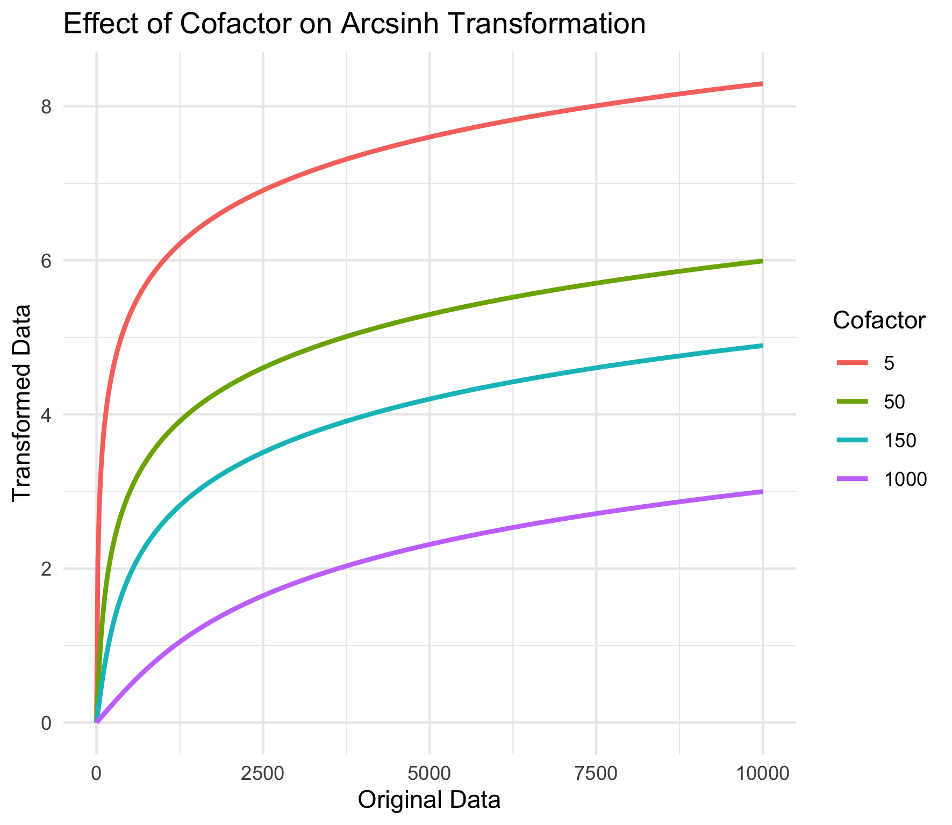
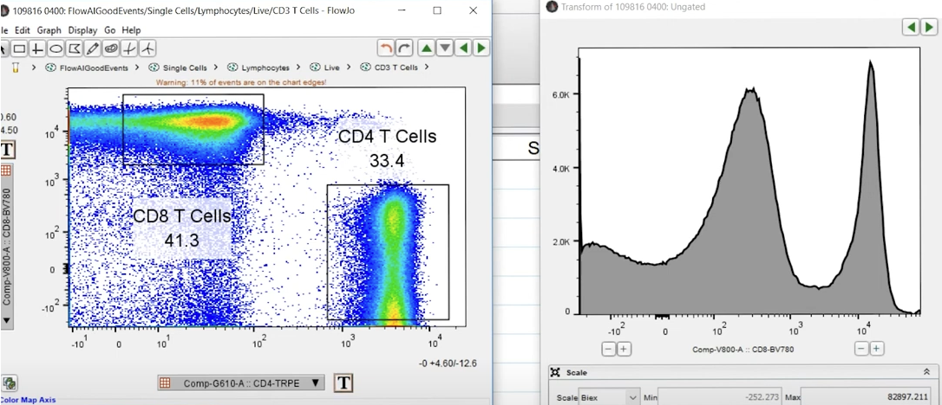
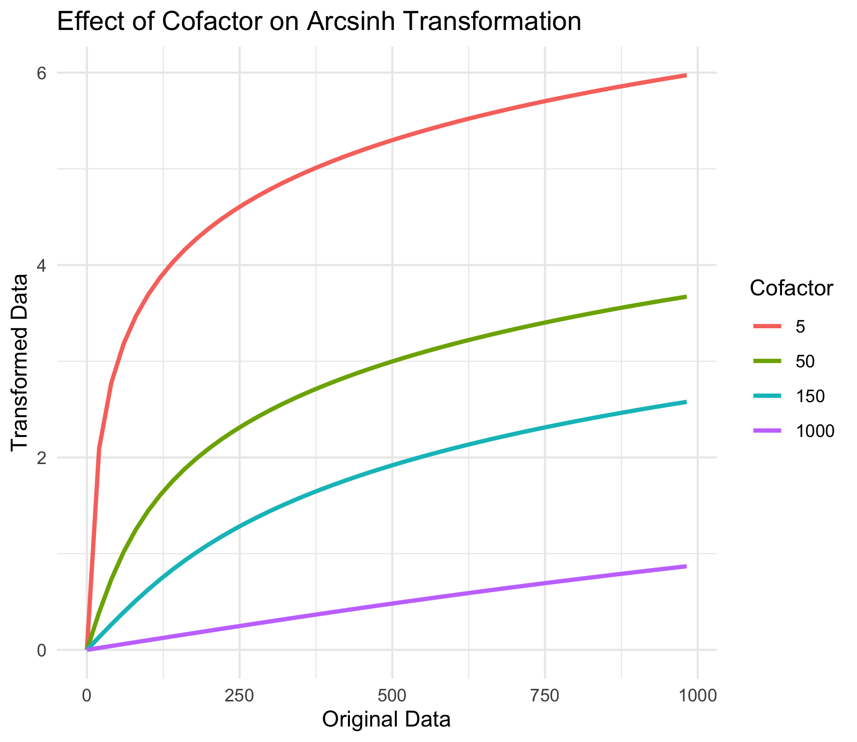
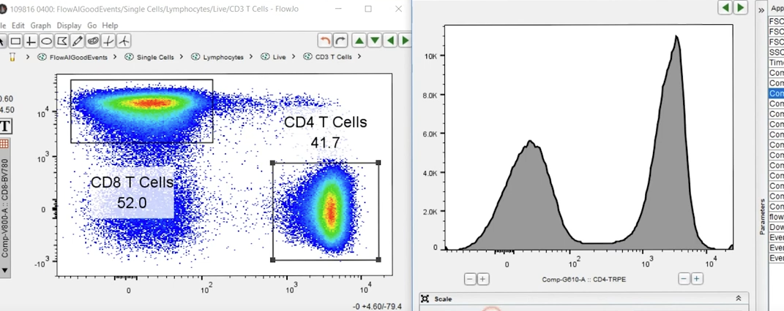
Types of transformation: Log transformation, biexponential, Hyperlog, Generalized Box-Cox, Logicle, Arcsinh
Inverse hyperbolic sine (arcsinh)
Arcsinh behaves similarly to a log transformation at high values and is approximately linear for values up to the cofactor.
The cofactor controls the width of the linear region
Cofactor 5 or 150 for MC and FC, respectively
Example on FlowJo
Up to 1000 original value

Slide 4
Transformation strategies (selecting the parameters):
Global —the same parameters for all channel
Channel-specific
Manual
Advantages:
Customization
Expert insight
Disadvantage:
Time-consuming
Inconsistency between users
Not scalable
Could be biased
Automated
Advantages:
Time-efficient
Consistent between users
Scalable
Objective and reproducible
Disadvantage:
Less transparent (can be solved with outputs and visualizations)
Less control

Slide 5
Some tools for automated channel-specific transformation:
flowTrans (estimates transformation parameters for each sample by maximizing the likelihood of data being generated by a multivariate-normal distribution on the transformed scale)
flowScape (optimizes the normalization factor of asinh transformation by the Jarque-Bera test of normality)
FCSTrans (selects the parameters of the linear, logarithm, and logicle transformations with an extensive set of simulations)
FlowVS (stabilizes the variance within cell populations in each fluorescence channel for the entire collection of samples)
Azad et al., BMC Bioinformatics (2016)

Slide 6
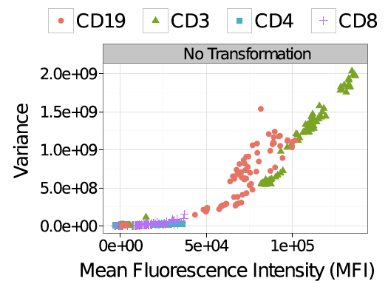
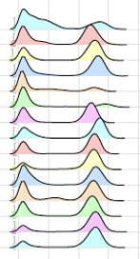
FlowVS
Stabilizes the variance within cell populations in each fluorescence channel for the entire collection of samples.
Normalizing data may not necessarily stabilize its variance.
The origin of the problem:
Variance of the fluorescence signal increases with the average signal Intensity.
Variance stabilization (VS) is a process for dissociating data variability from mean signals.
Enabling standard statistical methods to be applied for between-population comparisons
Every peak is a cell population.
Azad et al., BMC Bioinformatics (2016)

Slide 7
FlowVS workflow:
Transforming each channel in each sample
Detecting density peaks
Collecting density peaks from all samples
Computing Bartlett’s test statistic (testing homogeneity of variances)
Repeating the above steps for a range of cofactors
Finding a cofactor for optimum VS (minimum value of Bartlett’s statistic)

Slide 8
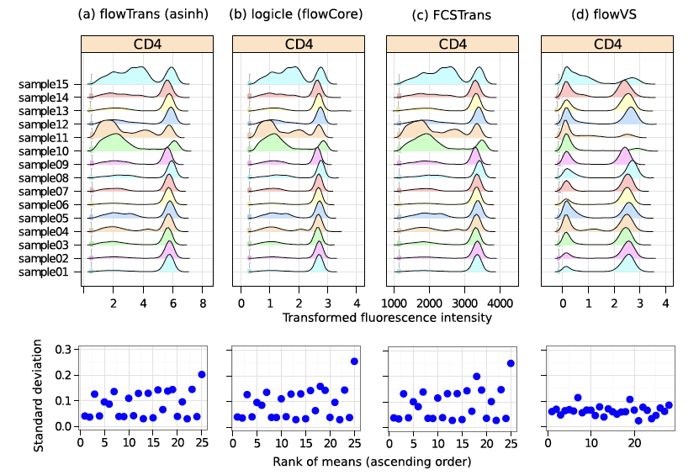
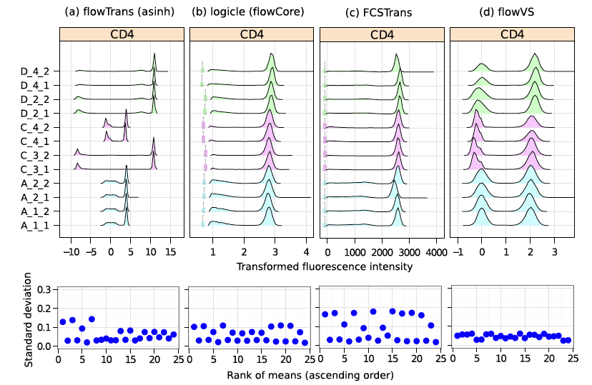
Comparing FlowVS with other tools in terms of variance stabilizing
FlowVS doesn’t try to match the MFI of peaks between samples.
Dataset 1
Dataset 2
Azad et al., BMC Bioinformatics (2016)

